Slide 1
Mining Binary Constraints in Feature Models: A Classification-Based Approach
Li Yi
Peking University
October 22, 2011

Slide 2
Agenda
Introduction
Approach: Details
Experiments
Conclusions & Future Work

Slide 3


Background: Feature Models
Feature Model
Build (Domain Engineering): Requirements Feature + Constraints
Reuse (Application Engineering): Select a subset of features without violating constraints
EXAMPLE: A Feature Model of Audio Playing Software Domain
Audio Playing Software
Audio CD Codec
Burn CD
Platform
$$×$$
Optional
Mandatory
Mobile
PC
XOR-Group
Requires
$$×$$
Excludes

Slide 4
Finding Constraints is Challenging
The size of problem space is O(|Feature|²)
Feature: Often concrete, can be directly observed from an individual product vs. Constraint: Often abstract, have to be learned from a family of similar products
My Experience: Finding constraints becomes a headache for 30+ features
☹BAD NEWS: Domains in the real world tend to have hundreds of features
We try to provide some automated support for finding constraints on a given set of features.

Slide 5
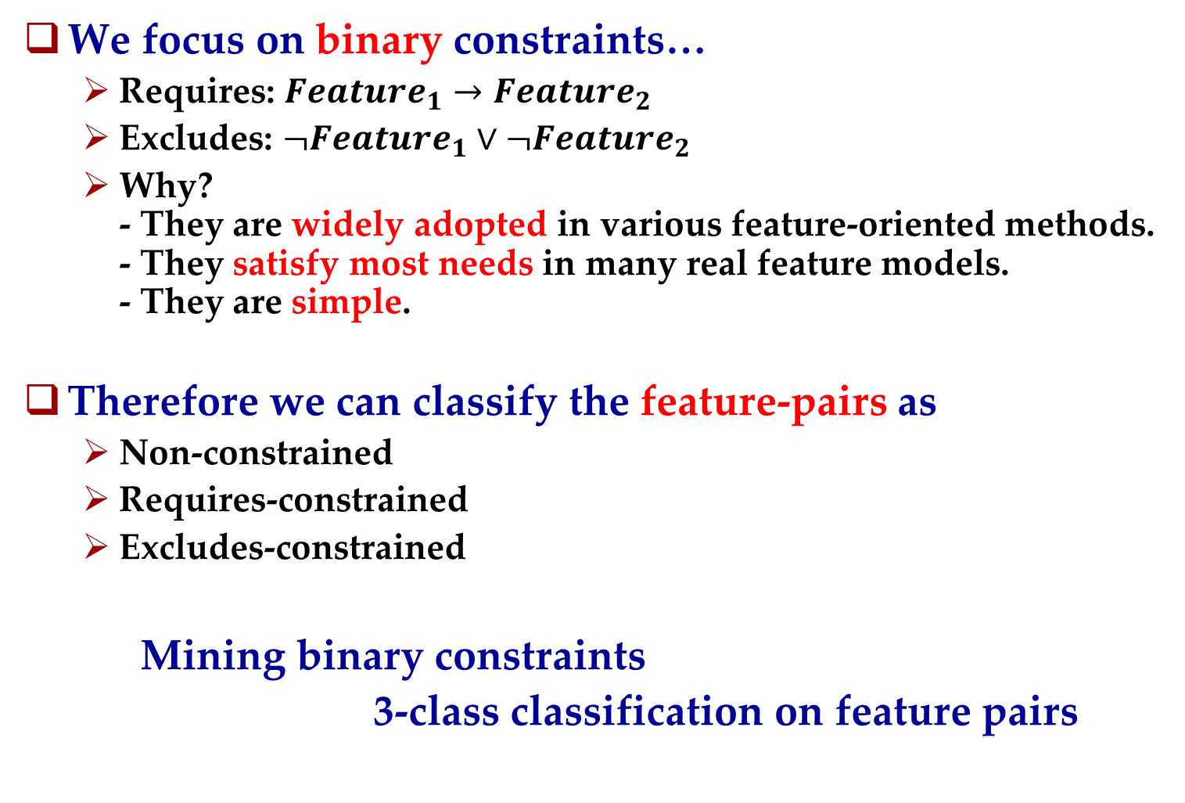
Our Basic Idea
We focus on binary constraints…
Requires: $Feature_{1}→Feature_{2}$
Excludes: $¬Feature_{1}∨¬Feature_{2}$
Why? - They are widely adopted in various feature-oriented methods. - They satisfy most needs in many real feature models. - They are simple.
Therefore we can classify the feature-pairs as
Non-constrained
Requires-constrained
Excludes-constrained
Mining binary constraints
3-class classification on feature pairs

Slide 6
Approach Overview
Training & Test FM(s)
Make Pairs
Training & Test Pair(s)
Stanford Parser
Quantify Pairs
Training Vector(s)
Classifier
Optimize & Train
Trained Classifier
LEGEND
Test Vector(s)
Test
Automated Action
Classified Test
Pair(s)
Data
External Tool

Slide 7
Agenda
Introduction
Approach: Details
Make & Quantify Feature Pairs
Experiments
Conclusions & Future Work

Slide 8


Make Pairs
The pairs are cross-tree only and unordered
Cross-tree only: The 2 features in a pair have no “ancestor-descendant” relation
The inner-tree constraints are better expressed by refinement relationships (i.e. Optional and Mandatory).
Feature Tree
A
$$×$$
B
C
(A, B) (A, X) (A, Y) (A, C) (B, X) (B, Y)
.
.
.
.
.
.
X
…
Y
(B, C) (X, Y) (C, X) (C, Y)
Unordered: (A, B) == (B, A) Therefore is_requires(A, B) means A requires B or B requires A or both
Reason: no_constraint and excludes are unordered, so we decide to treat requires as unordered as well.

Slide 9
Quantify Pairs
Feature Pair
Feature Pair
name₁: String
name₂: String
description₁: Text
description₂: Text
attribute₁: Number
attribute₂: Number
…(more)
Classifiers work with numbers only.
We measure 4 numeric attributes for pair (A, B)
Similarity between A.description and B.description
Similarity between A.objects and B.objects
Similarity between A.name and B.objects
Similarity between A.objects and B.name
Similar Feature
Overlapped Function Area
One is targeted by another
These phenomena may indicate dependency / interaction between the paired features, and in turn, indicate constraints between them.

Slide 10
Extract Objects
We use Stanford Parser to perform grammatical analysis on feature descriptions. (It supports both English and Chinese.)
For English sentences, we extract objects (direct, indirect, prepositional) and any adjectives modifying the objects.
An Example
Use a PDF driver to output or publish web calendars so anyone on
your team can view scheduled events.
Direct Objects
Direct Objects
Adjective Modifier
Direct Object

Slide 11

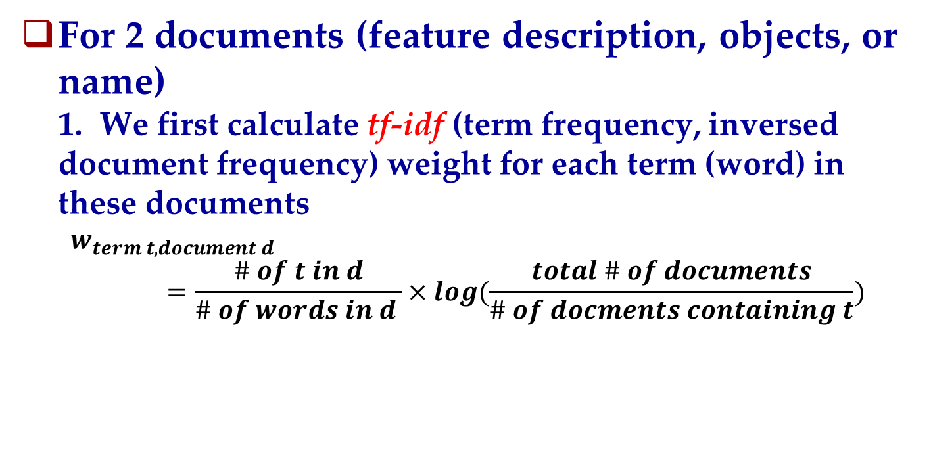
Calculate the Similarity
For 2 documents (feature description, objects, or name) 1. We first calculate tf-idf (term frequency, inversed document frequency) weight for each term (word) in these documents
$$w_{term t, document d}=\frac{\# of t in d}{\# of words in d }×log(\frac{total \# of documents}{\# of docments containing t})$$
tf
idf
2. Thus a document = a vector of tf-idf weights:
$$Similarity_{vector v_{1}, vector v_{2}}=\frac{v_{1}∙v_{2}}{|v_{1}|×|v_{2}|}$$
dot-product

Slide 12
Agenda
Introduction
Approach: Details
Optimize and Train the Classifier
Experiments
Conclusions & Future Work

Slide 13
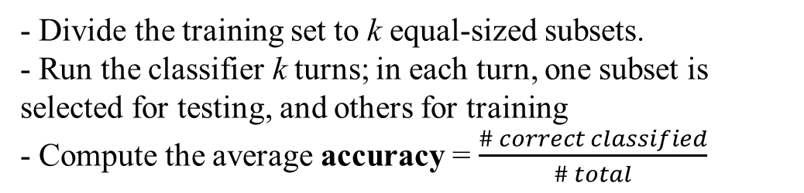
Optimize and Train the Classifier
We use LIBSVM, a support vector classifier
Optimize
Running k-fold cross validation on the training set, we get the classifier accuracy.
Different classifier parameters give different accuracy
We use a genetic algorithm to find best parameters
Train
After optimization, the classifier are re-trained by the best parameters
- Divide the training set to k equal-sized subsets.
- Run the classifier k turns; in each turn, one subset is selected for testing, and others for training
- Compute the average accuracy = $\frac{\# correct classified}{\# total}$
k = 4

Slide 14
Agenda
Introduction
Approach: Details
Experiments
Conclusions & Future Work

Slide 15
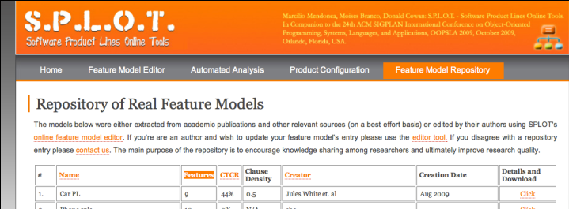
Experiments: Data Preparation
Principle: The feature models should be built without being aware of our approach.
2 feature models from SPLOT Feature Model Repository (no feature description)
Graph Product Line: by Don Batory (81 pairs)
Weather Station: by pure-systems corp. (186 pairs)
Add Feature Description
Most features are terms defined on Wikipedia, we use the first paragraph (i.e. the Abstract) as descriptions.

Slide 16
Experiment Design
2 Categories
Generate Training & Test Set
Optimize, Train and Test
Result
No Feedback
Generate Initial Training & Test Set
Training & Test Set
Optimize, Train and Test
Check a few predicted constraints
Result
Limited Feedback
(An expected practice in real world)
Add checked results to training set;
Remove checked results from test set
4 Training / Test Set Selection Methods
1. Training = FM₁, Test = FM₂
2. Training = FM₁ + Small Part of FM₂, Test = Rest of FM₂
3. Training = Small Part of FM₂, Test = Rest of FM₂
4. The same as 3, but do Iterated Labeled-Unlabeled (LU) Training (a more sophisticated training strategy)

Slide 17
Results
Comparison of Selection Methods
Small Part = 1/5, Test FM = Graph Product Line (81 pairs, including 8 requires and 1 excludes)
Method | Accuracy | Requires |  | Excludes
 |  | Precision | Recall | Precision | Recall
1 | 77.78% | 22.72% | 83.3% | -- | 0
2 (Run 5 times) | 84.01% | 45.54% | 52% | 100% | 20%
3 (Run 5 times) | 88.31% | 69.44% | 21.02% | 100% | 20%
4 (Run 5 times) | 89.23% | 76.08% | 23.25% | 100% | 20%
Effect of Limited Feedback (Check 3 Predictions)
Accuracy (%)
Accumulated Feedback #

Slide 18
Agenda
Introduction
Approach: Details
Experiments
Conclusions & Future Work

Slide 19
Conclusions & Future Work
Conclusions
Binary constraints between features → Classification on feature-pairs
Define attributes according to possible dependency or interaction between paired features
Accuracy is reasonably high
Method 1 (gives higher recall) and Method 4 (gives higher precision) may be preferred
Limited Feedback improves the accuracy
Future Work
More linguistic analysis (verb, time, etc.) & experiments
Incorporate the Stanford Parser for Chinese into our feature modeling tool, and therefore we can do evaluation in real scenes.

Slide 20
THANK YOU ! Q&A

